Slide 1
Supervised Learning Part 2 – Model Interpretability & Prediction Intervals
Zou Yumeng, Ranon Sim (Advanced Analytics)

Slide 2
Part 2 Agenda – Model Interpretability
Model Interpretability
Shap Value
Summarization

Slide 3
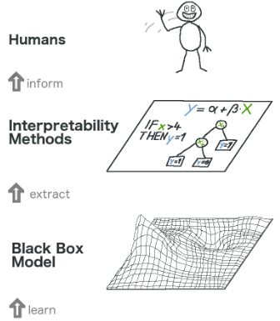
Interpretability
Algorithm transparency
Global model interpretability
Global model interpretability on a modular level
Local interpretability for a single prediction
Local interpretability for a group predictions

Slide 4
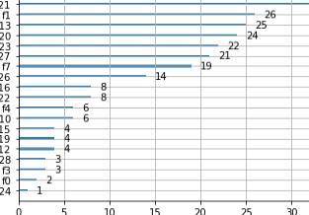
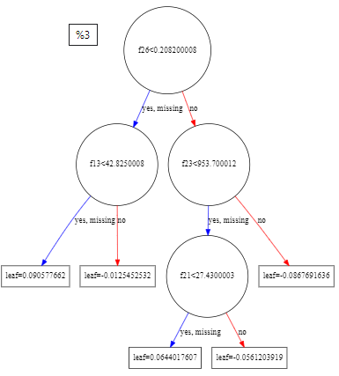
Tree Interpretability
Feature importance
Tree decomposition
Advantages:
Natural visualization
Good explanations
Disadvantages:
Fail to deal with linear relationship
Cannot handle deep depth tree

Slide 5
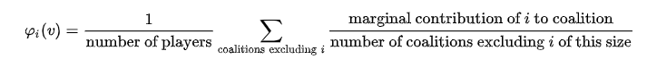
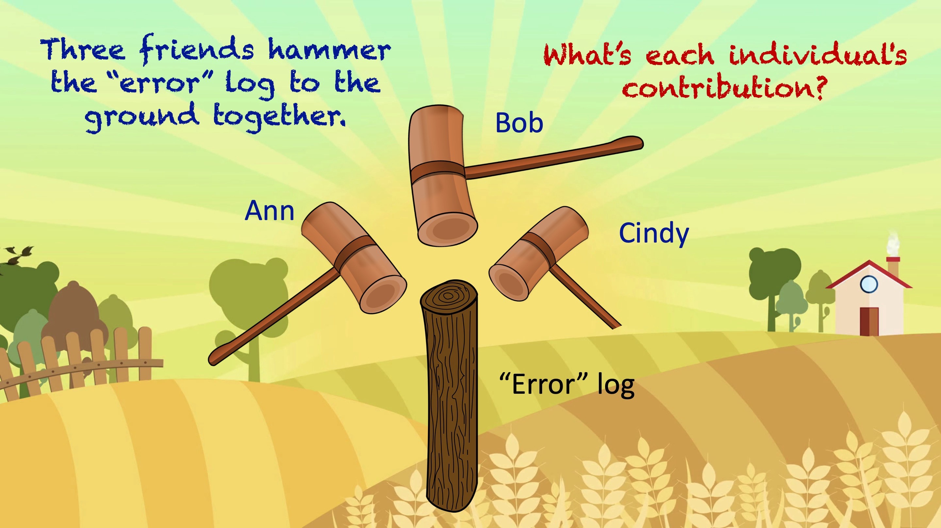
SHapley Additive exPlanations
SHAP (SHapley Additive exPlanations) is a game theoretic approach to explain the output of any machine learning model. It connects optimal credit allocation with local explanations using the classic Shapley values from game theory and their related extensions.
Global interpretability
Local interpretability
Can be calculated for any tree-based models

Slide 6

Shap Values Application
Shap values:
TreeExplainer: Support XGBoost, LightGBM, CatBoost and scikit-learn models by Tree SHAP.
DeepExplainer (DEEP SHAP): Support TensorFlow and Keras models by using DeepLIFT and Shapley values.
GradientExplainer: Support TensorFlow and Keras models.
KernelExplainer (Kernel SHAP): Applying to any models by using LIME and Shapley values.
It also has LinearExplainer, PartitionExplainer, SamplingExplainer.

Slide 7
Hands-on
XGBoost
LightGBM
Catboost
Shap Value

Slide 8
Summarization (Base on hands-on trials)
1. For binary and multi classification, consider XGBoost, if it is large dataset, LightGBM will be a good choice
2. For prediction, LightGBM will be a good choice.
3. scale_pos_weight can be used to solve imbalance data problem.
Do recommend Shap value when try to explain the complicated models.
1. It can explains from global and individual level
2. It can support almost all the ML models
 | XGBoost | LightGBM | CatBoost
Training Time( 28483* 31 cols) | Around 100 seconds | Around 10 seconds | Performs quite bad with numerical data
Accuracy (binary classification)(accuracy) | 0.976 | 0.964 | 0.976
(multi classification) | 0.91 | 0.88 | 0.91
(price prediction)(mean absolute error) | 0.14 | 0.09 | 0.08

Slide 9



Did you try…?
Can I see…?
Show me more…

Slide 10
Part 2 Agenda – Prediction Intervals
Why Calculate Prediction Intervals?
What is a Prediction Interval?
What is a standard way to build a Prediction Interval ?
Implementing Prediction Intervals using Scikit-Learn
Drawbacks of the Scikit-Learn package
Prediction Intervals for various models (linear models to trees)
How to output results of a Prediction Intervals?
References
https://machinelearningmastery.com/prediction-intervals-for-machine-learning/
https://towardsdatascience.com/how-to-generate-prediction-intervals-with-scikit-learn-and-python-ab3899f992ed
https://towardsdatascience.com/quantile-regression-from-linear-models-to-trees-to-deep-learning-af3738b527c3
https://vladgladkikh.wordpress.com/2018/06/08/confidence-and-prediction-intervals-using-the-bootstrap/
https://medium.com/@qucit/a-simple-technique-to-estimate-prediction-intervals-for-any-regression-model-2dd73f630bcb

Slide 11
Why Prediction Intervals “All models are wrong, but some are useful” — George Box.
Regression Problems (prediction/forecast)
A single value (point prediction) is often predicted without a measure of its certainty. This assumes 100% certainty in the model’s output.
Reality
There is no such thing as 100% confidence when all models are an estimation of the real world. They are built around assumptions in the input / output features e.g. the distributions.
The uncertainty comes from the errors in the model itself and noise in the input data. The model is an approximation of the relationship between the input variables and the output variables.
So why then?
It all links back to honesty. We want to be data scientist that are honest about the limitations of our model's actual performance capabilities.

Slide 12
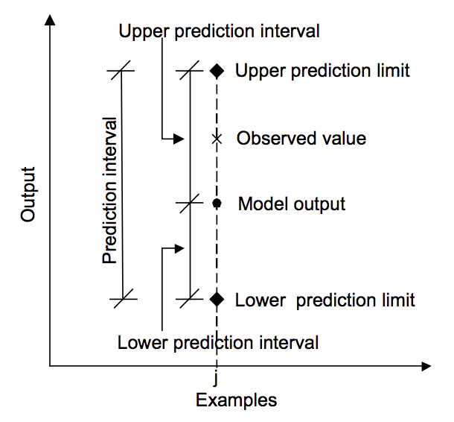
What is a prediction interval?
A prediction interval is a quantification of the uncertainty on a prediction
It tells us the likelihood/certainty level of a prediction target value being the actual true value
An example of the presentation of a prediction interval is as follows:
Given a prediction of ‘y’ given ‘x’, there is a 95% likelihood that the range ‘a’ to ‘b’ covers the true outcome.

Slide 13
Using Quantile Regression to build a Prediction Interval
What is Quantile Regression?
Regression that makes no assumptions about the distribution of the residuals.
What does a prediction interval built with quantile regression reveal?
It aims at estimating the conditional quantiles (the most common is the median) of the response variable instead of a RMSE estimate of the conditional mean.
Example: An model that estimates the waiting time for a taxi to be 22 Minutes at the 0.95 Quantile means "The probability that the waiting time is <=22 minutes is 95%"
What is a standard way to compute prediction intervals using Quantile Regression?
Combine 2 Quantile Regressor Models (Upper and Lower quantile estimators) to build a Prediction Interval surrounded by the sets of predictions generated by the two models (that act as an upper and lower boundary for where the true value might be found)
E.g. Estimates from a 0.05 quantile model and 0.95 quantile model will be used to compute a 0.95-0.05 = 0.9 prediction interval
Intuition: The Prediction Interval will contain approximately 90% of the actual samples (actual target results)

Slide 14
Implementing Prediction interval using Scikit-Learn’s Gradient Boosting Regressor
*Open Jupyter Notebook Demo*
Reference:
https://towardsdatascience.com/how-to-generate-prediction-intervals-with-scikit-learn-and-python-ab3899f992ed
https://nbviewer.jupyter.org/github/WillKoehrsen/Data-Analysis/blob/master/prediction-intervals/prediction_intervals.ipynb

Slide 15
Drawbacks of the Sckit-Learn package
Quantiles generated using the Gradient Boosting Regressors produce prediction intervals that are far away from the true values
Each quantile [0,0,2,0,3....0.99] requires training a new quantile regressor model. i.e. v computationally intensive
Not all types of regression models can be used: In Scikit-learn, only the Gradient Boosting Regressor is used. XGBoost etc. needs to be customized

Slide 16
Prediction Intervals for various models (linear models to trees)
*Open Jupyter Notebook Demo*
Reference:
https://towardsdatascience.com/quantile-regression-from-linear-models-to-trees-to-deep-learning-af3738b527c3
https://colab.research.google.com/drive/1nXOlrmVHqCHiixqiMF6H8LSciz583_W2#scrollTo=hn3sxw4yDXdz

Slide 17
How to output prediction intervals?
*Open Jupyter Notebook Demo*
Reference:
https://towardsdatascience.com/quantile-regression-from-linear-models-to-trees-to-deep-learning-af3738b527c3
https://colab.research.google.com/drive/1nXOlrmVHqCHiixqiMF6H8LSciz583_W2#scrollTo=hn3sxw4yDXdz

Slide 18
Thank you

